Slide 1

Enhanced Image Restoration
Combining Convolution and Linear System Solving to restore damaged images

Slide 2

Team members
Prathamesh Kumar Singh [PES1UG24CS341]
1
2
Puneeth Yenneti [PES1UG24CS348]
3
Prithviraj Ajay Patil [PES1UG24CS345]
4
Ramith Munnan Ravindranath
[PES1UG24CS367]

Slide 3
Why does this matter?
  Real-world images get corrupted — bad sensors, transmission errors, interference
  A damaged image is just a matrix with wrong numbers
  Goal: use mathematics to recover the original pixel values
  Two mathematical tools: Convolution (noise removal) + Linear Systems (reconstruction)

Slide 4
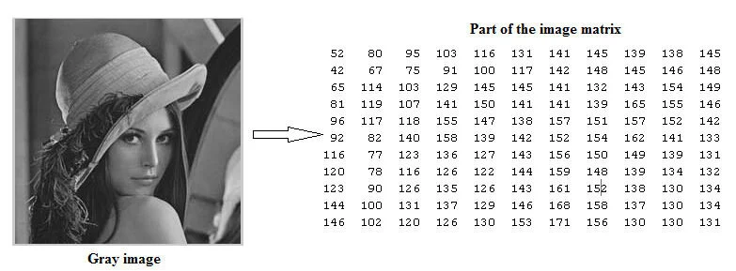
Image as a Matrix
  Every image is a 2D matrix of numbers
  Each value = pixel brightness (0 = black, 255 = white)
  A 100×100 image = 10,000 numbers
  All image operations are just matrix math

Slide 5
Our Approach
The Pipeline
Original Image
Add Noise
(simulate damage)
Gaussian Blur (reduce noise via convolution)
Linear System Solve (reconstruct)
Residual Analysis

Slide 6
Step 0: Adding Noise
What is noise?.
In real-world scenarios, images get corrupted — by a bad camera sensor, transmission errors, or interference. We simulate this using np.random.normal(0, 20, shape) which adds random Gaussian noise to every pixel.
  Mean = 0 (noise is centred around zero, not biased)
  Std = 20 (noise can shift pixel values by roughly ±20 brightness units)
Goal of this step: Create a realistic "damaged" image that we will try to restore

Slide 7
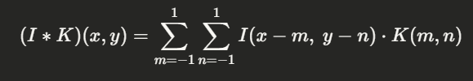
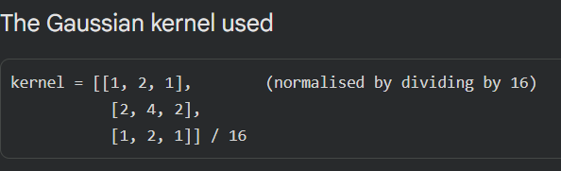
Step 1: Gaussian Blur (Convolution)
Convolution slides a small matrix called a kernel across the image. At each position, it multiplies the kernel values with the overlapping pixel values and sums them up to produce a new pixel value.
For each pixel position, multiply every kernel value with the corresponding overlapping pixel value, then sum all products to produce the new pixel
This kernel gives more weight to the centre pixel and less to the edges, which smooths out random noise spikes.

Slide 8
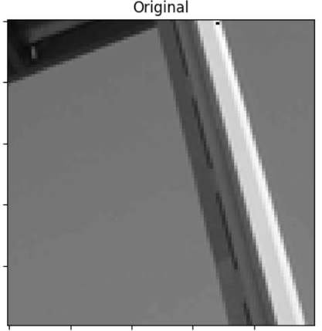
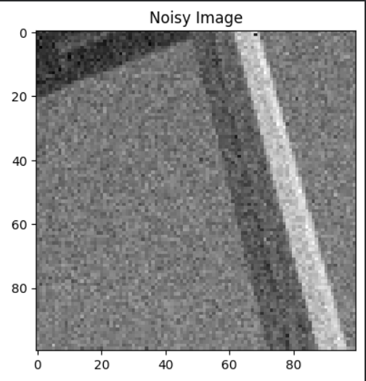
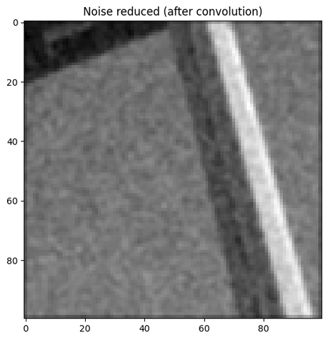
Step 1: Gaussian Blur (Continued...)
Why does this reduce noise?
Random noise affects individual pixels independently. Averaging each pixel with its neighbours cancels out those random spikes — because noise in one pixel is unlikely to match noise in adjacent pixels.
Trade-off
Blurring reduces noise but also reduces sharpness. Fine edges and details get slightly smoothed. The next step attempts to recover some of that detail using linear system solving

Slide 9
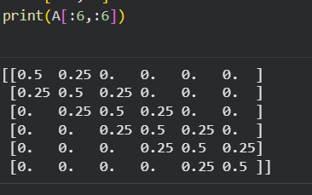
Step 2: Linear System Setup
Turning Reconstruction into Ax = b
  Blurring is a linear operation — it can be written as Ax = b
    b = blurred image row (known)
    x = original image row (unknown)
    A = tridiagonal matrix built from the blur kernel
Building Tridiagonal matrix A
  The 1D Gaussian kernel middle row is [1, 2, 1] / 4 = [0.25, 0.5, 0.25], meaning:
    each pixel = 0.25 × left neighbour + 0.5 × itself + 0.25 × right neighbour
  This relationship becomes a tridiagonal matrix A of size (100×100):
    Main diagonal = 0.5 (centre pixel weight)
    Off-diagonals = 0.25 (neighbour weights)
  Solving Ax = b with this A undoes exactly what the blur did — row by row across the image.

Slide 10
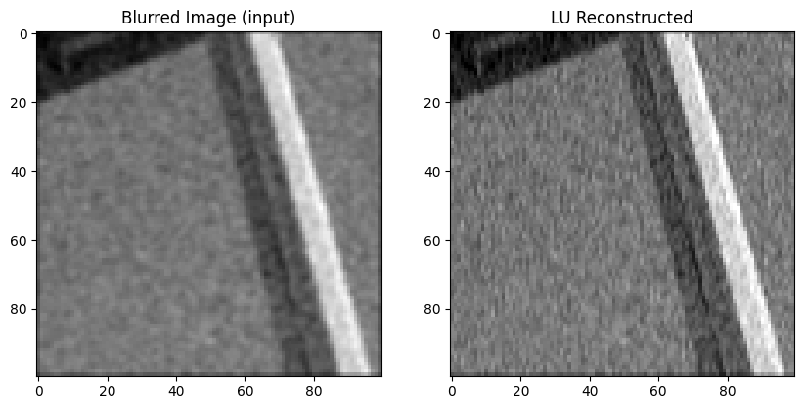
Part (i): Full Image Reconstruction using LU Decomposition
Solving Ax = b with LU Decomposition
  LU factorises A into three matrices: A = P · L · U
  P = permutation (row reordering for stability)
  L = lower triangular (forward elimination)
  U = upper triangular (back substitution)
  Key advantage: factorise A once, solve 100 rows cheaply
Solving this system for each row reverses the blur and recovers an approximation of the original pixel values.

Slide 11
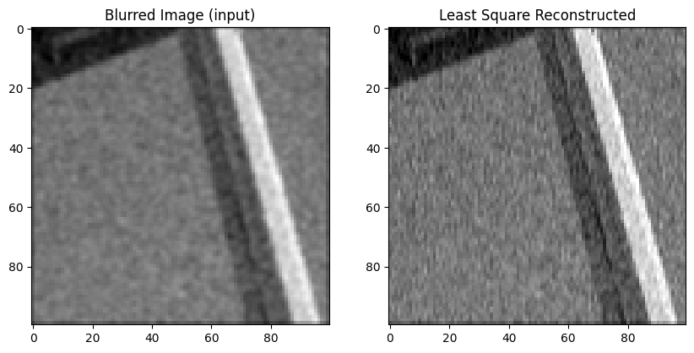
Part (ii): Full Image Reconstruction using Least Squares
Solving Ax = b with Least Square method
  Least Squares solves Ax = b by minimising ||Ax - b||² — the sum of squared differences.
  More robust when A is not perfectly invertible
  Does NOT reuse factorisation — recomputes every row from scratch
  np.linalg.lstsq(A, b, rcond=None)
  Same mathematical result as LU but different approach
Solving for all the rows reverses the blur and recovers an approximation of the original pixel values.

Slide 12
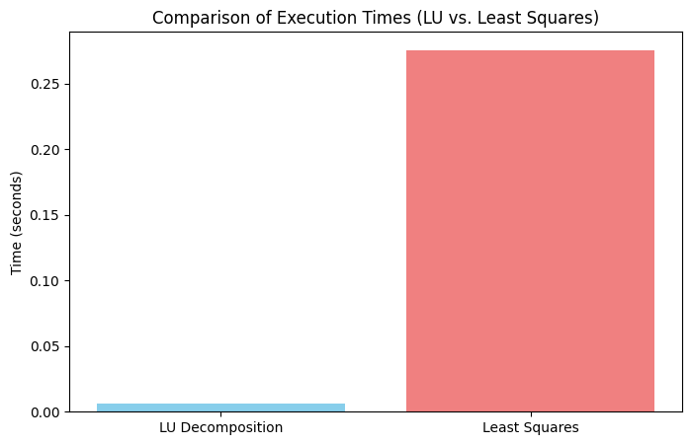
Performance Analysis
Summary of Execution Times
  LU Decomposition is practically ~100 times faster* than Least Squares for solving this system.
  Thus LU Decomposition is much effiecient
(*depends on the amount of noise ).
Why is it so much faster?
  Factorize Once: LU computes the expensive matrix breakdown once (O(N3)) and reuses it for every iteration.
  Efficient Solving: The loop only handles back-substitution, which is significantly faster (O(N2)).
  Avoid Redundancy: Standard solvers treat each iteration as a brand-new problem, wasting time recalculating the same decomposition.

Slide 13
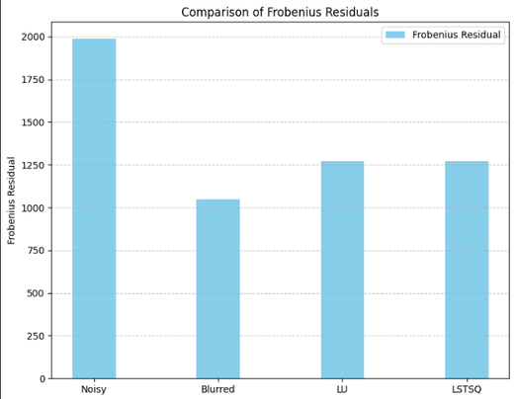
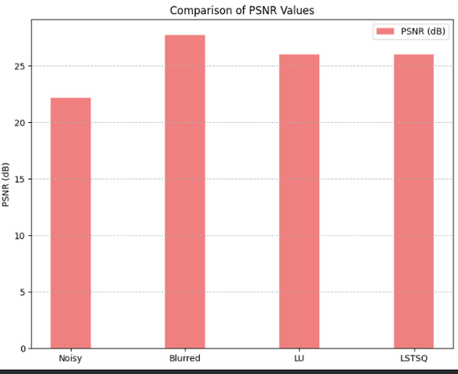

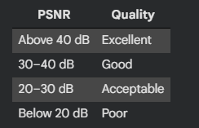
Step 3: Residual Analysis - Measuring Reconstruction Quality
  Frobenius Residual
    r = ||reconstructed - original||F
    The Frobenius norm squares every pixel difference, sums them all, and takes the square root. It gives a single number representing total error across the whole image.
    Lower residual = closer to original = better restoration.
  PSNR (Peak Signal-to-Noise Ratio)
PSNR is standardised in decibels (dB) so it can be compared across different images and projects.

Slide 14
Applications
Medical Imaging
Surveillance Systems
Photography & Mobile Cameras
Digital Forensics
→ MRI and CT scans often contain noise
→Restoration improves diagnostic accuracy
→ CCTV footage is often noisy and low-quality
→Denoising helps identify faces and objects
→ Low-light images contain noise and blur
→Convolution filters restore clarity
→ Crime evidence images may be damaged or unclear
→Linear reconstruction recovers lost detail

